Slide 1

ANALYZING AN ORGANIZATION’S PERFORMANCE TO PREDICT FUTURE STOCK MOVEMENT
GROUP -1

Slide 2
Problem Statement
Any organization’s performance can be outlined by reviewing the following aspects:
Customers Feedback
Performance of Share
Employee Feedback
News bytes/ Overall Sentiment
Management Outlook
Sector/ Market’s performance
Large Funds & Broker house recommendations
We intend to take all the above aspects and build a solution to help rate organization(s)/ industry sector. This rating can then help predicting whether investing in this organization for a period (short/ long term) makes sense.

Slide 3
Current Scope
In the current project, we will be collecting data from various sources to build a data repository, which can be then fed to the ML model. Current project only addresses the data collection.
Source | Aspect | Description
https://www.twitter.com/ | Customers Feedback Shareholders Feedback Broker Recommendations | Social Media like Twitter can provide us with general sentiments of both Large Funds/Brokers, Retail stock holders and general public
https://in.finance.yahoo.com/ | Performance of Share | Historical stock prices and trends; along with chart analysis can provide an insight of how the stock is expected to perform.
https://www.indeed.co.in/ | Employee Feedback | Employee satisfaction is a major aspect that can affect an organization in a long term.
https://newsapi.org/ | News bytes | Latest news can help a stock to soar or fall depending upon the positivity/ negativity.
Earnings Call Transcript** | Management Outlook | Earnings Call transcript provides the view of management outlook and can help derive the short term and long term strategy of the organization
https://www.moneycontrol.com/ | Sector/ Market’s performance | How the industry/ market sector is performing can unveil additional insights. Also, how the organization is performing against its competitors provides a good insight.
** - Not implemented in current project.

Slide 4


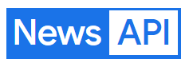


Collecting and Organizing Data
Unstructured Data
Package: twitter_scraper
https://www.twitter.com/
Unstructured Data
Text Pre-processing
Sentiment Analysis
Derive Overall Sentiment
Web Scraping: Selenium
https://www.indeed.co.in/
Unstructured Data
API Consumption: newsapi
https://newsapi.org/
Structured Data
Web Scraping: BeautifulSoup
https://www.moneycontrol.com/
Data Visualization
Time Series Analysis
Structured Data
Web Scraping: Selenium
https://in.finance.yahoo.com/

Slide 5
Pipeline
Text Pre-processing
Sentiment Analysis
Derive Overall Sentiment
Machine Learning Model to predict the trend
Expose the model through API
Request
Response
Data Visualization
Time Series Analysis
User provides the Stock Ticker as input
Data
Sources
Extraction
Data
Storage
Feature Pre-processing & Extraction
Training & Tuning the Model
Exposure & Consumption

Slide 6
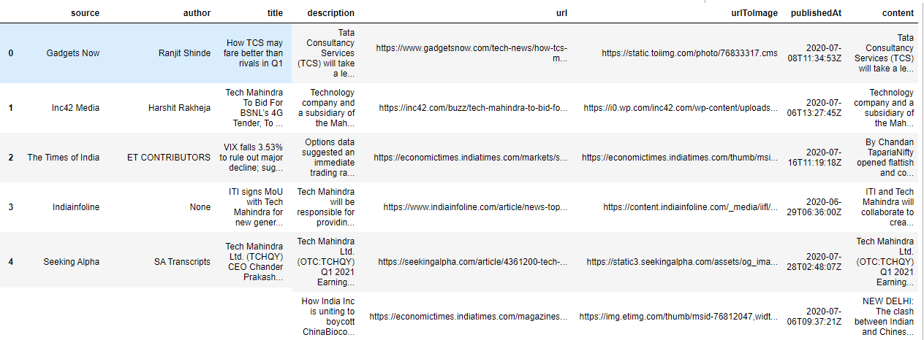
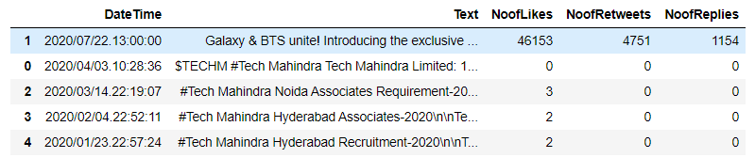
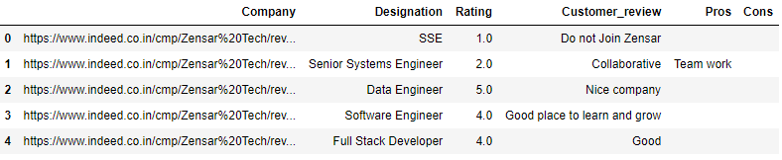
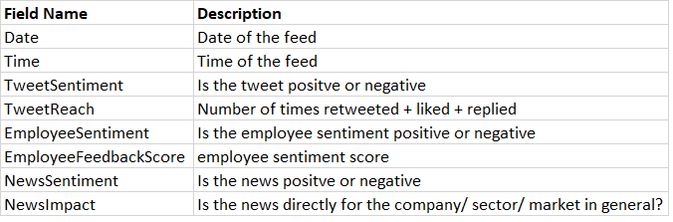
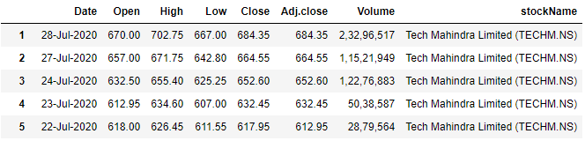
Data Collection Output
News Bytes Dataframe
Tweets Dataframe
Employee Review Dataframe
Feature Pre-processing & Extraction on above dataframes to provide a dataframe like below:
Both these combined will be provided as input to the ML model
stock prices Dataframe

Slide 7

Thank You
12010065 | Vasudev | Maduri | Vasudev_Maduri_AMPBA2021S@isb.edu
12010044 | Sonam | Lakhe | Sonam_Lakhe_AMPBA2021S@isb.edu
12010071 | KaliPrasad Raghavendra | Kuchibhotla | kaliprasad.kr_ampba2021s@isb.edu
12010066 | Debjit | Ray | Debjit_Ray_AMPBA2021S@isb.edu
12010045 | Ravikiran | Ravinuthala | Ravikiran_Ravinuthala_AMPBA2021S@isb.edu

